Slide 1

Psychology

Slide 2
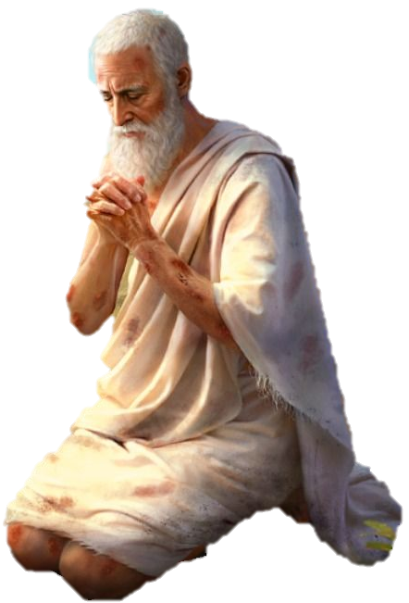
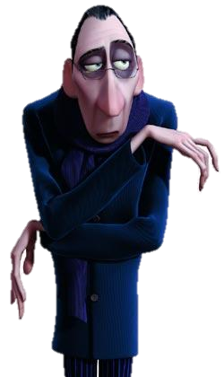

The Books of Wisdom
1st Easy overview Proverbs
2nd Critical view Ecclesiastes
3rd Connect better with GOD Job

Slide 3
Christian Psychology
Foundation: Rooted in biblical principles and the teachings of Christianity.
View of Human Nature: Emphasizes the spiritual aspect of human beings, recognizing the soul and its relationship with God.
Purpose: Aims to align psychological practices with Christian values, focusing on spiritual growth and healing.
Approach: Integrates faith and psychology (care for the soul), using scripture and prayer as part of the therapeutic process.
Therapists: Often trained in both psychology and theology, providing a holistic approach to mental health.
Notes:
Pastors have a success rate about 10% per session
Psychologist have less than 0.1% success

Slide 4
Trichotomous view
THE real NATURE OF MAN
Body
Soul
Spirit
Holy Spirit
Notes:
The Holy spirit is the down payment for our total final redemption
The deposit
The earnest

Slide 5
The Human members
Our tipple Intelligence
Physical
Spiritual
βίο Bio
Ζώη Zoe
Emotional
Ψύχε Psyche
Notes:
The Body functions
The Spirit
The holy spirit talks lead, so he can see, hear.
The Souls has eyes
Luke 16:23 And in hell he lift up his eyes, being in torments, and seeth Abraham afar off, and Lazarus in his bosom.

Slide 6
Biological Intelligence
Definition:
BI is the ability to store Information and Emotions , distinguish their fields of engagement and give back the information when requested by the Soul.

Slide 7
Spiritual Intelligence
Definition:
SI is the ability to deal with information and understand the purpose of it.
Notes:
The holy spirit talks leads, so he can see, hear.

Slide 8
Emotional Intelligence
Definition:
EI is the ability to discern, feel receive emotions and recognize the character of it.
Notes:
The soul has the same functions as the body Lk 16:23ff

Slide 9
Secular Psychology
Foundation: Based on the will there is no GOD a pseudoscientific research and empirical evidence limited to the physical realm.
View of Human Nature: Focuses on the mind and body, often excluding the spiritual dimension.
Purpose: Aims to understand and treat mental health issues through evidence-based practices.
Approach: Utilizes various psychological theories and techniques, such as cognitive-behavioral therapy, without incorporating religious elements.
Therapists: Typically trained in psychology and mental health, without a specific focus on religious or spiritual aspects.

Slide 10

Some theories

Slide 11
THE NATURE OF MAN
Body
Soul & Spirit
From Dichotomous to Monoblock

Slide 12
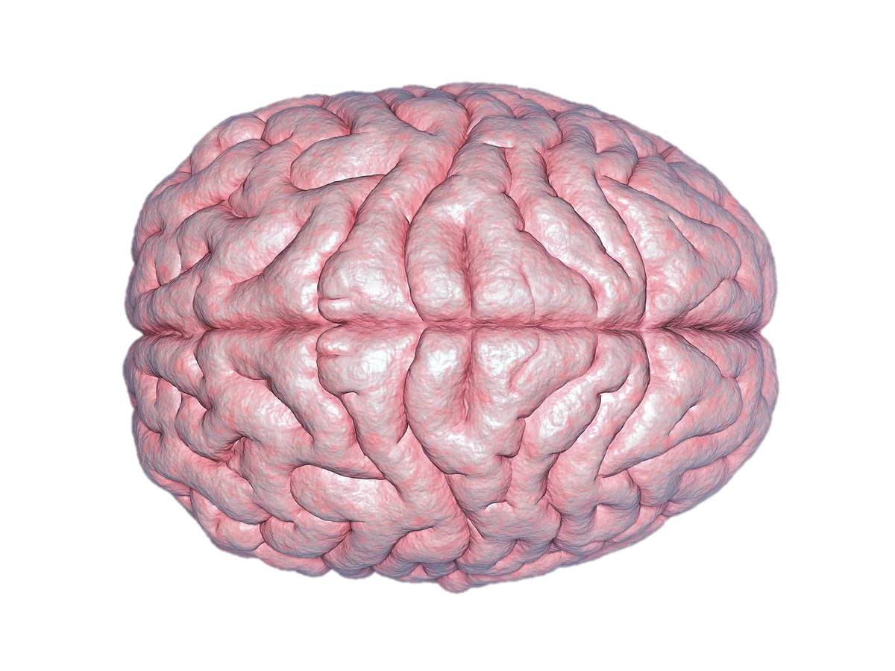

SQ
Spritual Intelligence
whole brain
IQ
Intellectual
Intelligence
left brain
EQ
Emtional
Intelligence
right brain

Slide 13


Slide 14

REGISTERED NURSES IN THE PHILIPPINES
Psychologists identify four type of Intelligence
Intelligence Quotient (IQ)
Emotional Quotient (EQ)
Social Quotient (SQ)
Adversity Quotient (AQ)

Slide 15
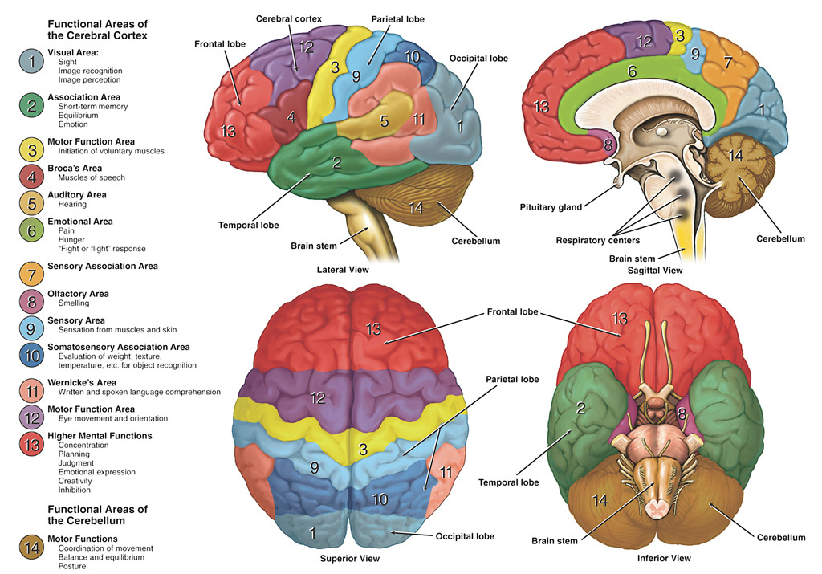

Slide 16
Lets get real
How does the invisible connection work?
How is body spirit and soul connected?

Slide 17
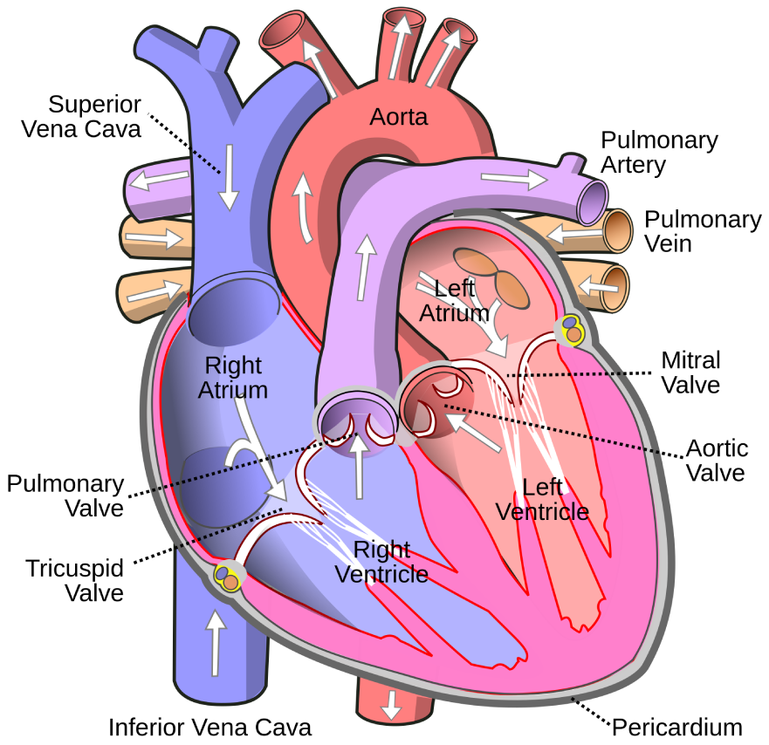
The heart
Vagus nerve
(parasympathetic)
Cardiac nerve
(sympathetic)
Sinoatrial
Node
Atrioventricular
Node
Notes:
3 elements we have not searched for the difficulty to examine them
Light is to fast
Fire is to hot
Plasma not easy
It seems through the heart is the entry point for the spirits outside of us

Slide 18
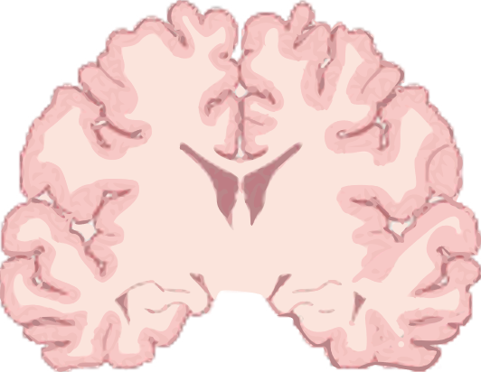
Heart Brain
Connection
Dorsal motor nucleus
of vagus nerve
Cardioaccelerator
centre (sympathetic)
Medulla
Vagus nerve
(parasympathetic)
Cardioinhibitory centre
(parasympathetic)
T1
T2
T3
T4
Pro 16:9 In his heart a man plans his course, but the LORD determines his steps.
T5
SA node
AV node
Cardiac nerve
(sympathetic)

Slide 19
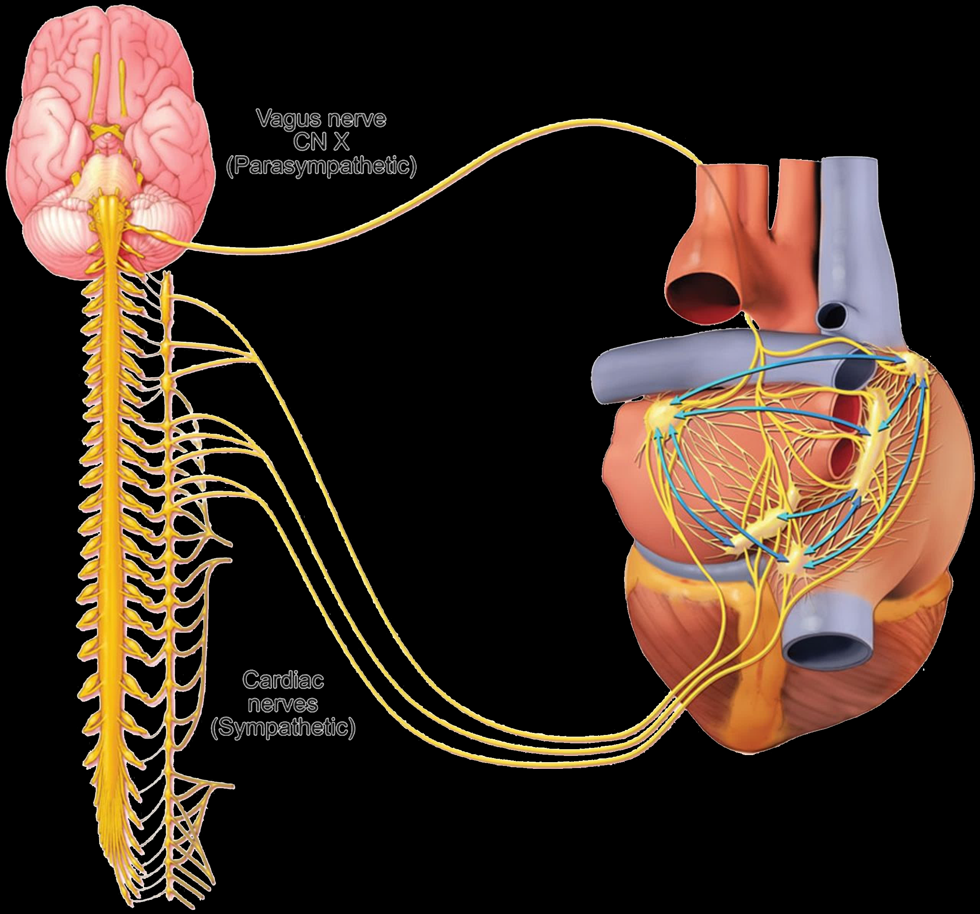
Sinoatrial
Node
Atrioventricular
Node

Slide 20
The connection of Life
Life is the difference
Existence is not enough
All approaches must include the invisible unphysical world or it will go wrong

Slide 21
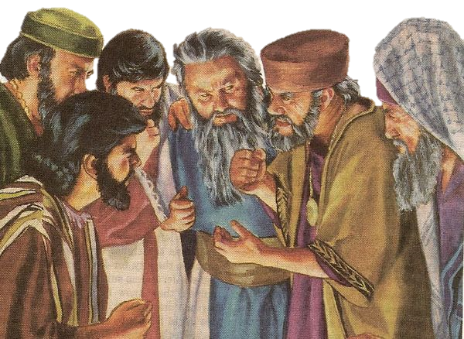
Differences
In essence,
Christian Psychology integrates
faith and spirituality
into the therapeutic process,
while
Secular Psychology relies on
physical scientific methods and
evidence-based practices only.
Like Sadducees
This Photo by Unknown Author is licensed under CC BY-SA-NC
Both approaches have their unique strengths and can be beneficial depending on the individual's beliefs and needs. Where Secular Psychology has good approaches in observing issues though the treatment is often a further destruction. There is no physical evidence for the soul that is in the invisible realm.

Slide 22
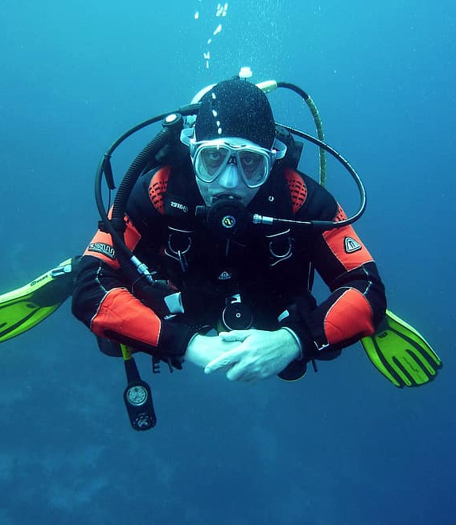

Let's dive into the major mistakes of secular psychology, their impact on mankind, and examples of anti-authoritarian education.

Slide 23

Major Mistakes of Secular Psychology
Exclusion of Spiritual Dimensions: Secular psychology often excludes spiritual and religious dimensions of human life, which are significant for many individuals. This exclusion can lead to an incomplete understanding of human behavior and mental health.
  Example: Viktor Frankl’s logotherapy emphasizes the importance of meaning and spiritual dimensions in psychological healing.
Notes:
[^1]: Vitz, Paul C. Psychology as Religion: The Cult of Self-Worship.
[^2]: Frankl, Viktor E. Man’s Search for Meaning.

Slide 24
Major Mistakes of Secular Psychology
Reductionism: Secular psychology tends to reduce complex human experiences to mere biological or psychological processes, ignoring the holistic nature of human beings.
Example: Critics have pointed out how behaviorist approaches like those of
B.F. Skinner often
neglect emotional and
existential dimensions.
Body
Soul
Spirit
Holy Spirit
Notes:
[^3]: Sarason, Seymour B. The Skeptic and the Teacher.
[^4]: Skinner, B.F. Beyond Freedom and Dignity.

Slide 25

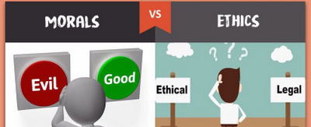
Major Mistakes of Secular Psychology
Ethical Relativism: Without a moral framework, secular psychology can struggle with ethical relativism, where moral standards become subjective and variable.
Quote: “When everything is relative, the smallest ethical dilemmas can become paralyzing.” - Paul Vitz
This Photo by Unknown Author is licensed under CC BY-SA-NC
This Photo by Unknown Author is licensed under CC BY-SA-NC
Notes:
[^5]: Ethical challenges in contemporary psychology, Journal of Moral Education, 2022.
[^6]: Quote from Psychology and Ethics in a Postmodern World
Relativism stands against faithfulness

Slide 26

Major Mistakes of Secular
Psychology
4. Overemphasis on Empiricism: While empirical evidence is crucial, an overemphasis on it can lead to the neglect of subjective experiences and personal narratives that are equally important in understanding human behavior. Example: Carl Jung’s work on archetypes and the collective unconscious highlighted the importance of subjective and symbolic experiences.
This Photo by Unknown Author is licensed under CC BY-SA-NC
Notes:
[^7]: Jung, Carl G. Modern Man in Search of a Soul.
[^8]: Case studies on Jungian therapy, The Journal of Analytical Psychology.

Slide 27

Major Mistakes of Secular Psychology
5. Medication often fails the patients need because they can only manage symptoms but are not able to go down to the real ground of the problem especially if it is from invisible influences.
This Photo by Unknown Author is licensed under CC BY-NC
Notes:
[^7]: Jung, Carl G. Modern Man in Search of a Soul.
[^8]: Case studies on Jungian therapy, The Journal of Analytical Psychology.

Slide 28
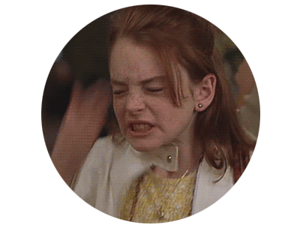
Impact on Mankind
Behavioral Issues:
The exclusion of spiritual dimensions can lead to a lack of meaning and purpose in life, contributing to existential crises and behavioral issues. Example: Increased rates of existential depression in modern societies.
Notes:
[^9]: Frankl, Viktor E. on existential crises, Logotherapy and Existential Analysis.
[^10]: Research on depression trends, World Psychiatry.

Slide 29
Impact on Mankind
2. Mental Health: Reductionism can result in inadequate mental health treatments that fail to address the root causes of psychological distress. Example: Ignoring cultural and spiritual factors in therapeutic interventions.
Notes:
[^11]: Lack of spiritual sensitivity in secular therapy, Spiritual Dimensions of Therapy.
[^12]: Cross-cultural psychology and therapeutic practices, 2021 studies.

Slide 30
Impact on Mankind
3. Ethical Dilemmas: Ethical relativism can lead to confusion and inconsistency in moral decision-making, affecting personal and societal well-being. Quote: “If the end justifies the means, who decides what ends are justified?” - Alasdair MacIntyre.
Notes:
[^13]: Ethical relativism in modern psychology, Psychology Today.
[^14]: MacIntyre, Alasdair. After Virtue.

Slide 31
Impact on Mankind
4. Loss of Personal Narratives: Overemphasis on empiricism can lead to the loss of personal narratives and subjective experiences, which are essential for holistic healing. Example: Narrative therapy restores these lost stories to empower individuals.
Notes:
[^15]: Effects of ignoring subjective experiences in therapy, Narrative and Psychotherapy.
[^16]: Narrative approaches in healing, The Routledge Companion to Narrative Therapy.

Slide 32
Antiauthoritarian Education
From a Christian perspective, antiauthoritarian education, which emphasizes the rejection of traditional authority and promotes self-directed learning, can be seen as a nuanced topic. Christianity values the concept of authority as ordained by God, such as parental guidance, teachers, and community leaders, emphasizing respect and obedience as part of a moral framework (e.g., Ephesians 6:1-4, Proverbs 22:6). Education is often viewed as a way to instill both knowledge and moral character under the guidance of responsible authority.

Slide 33
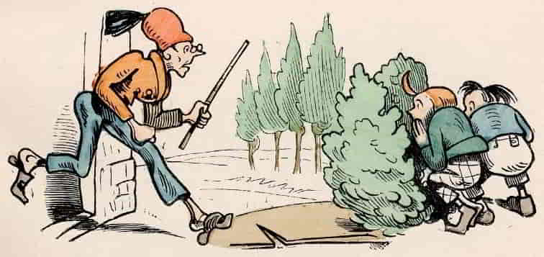
Proverbs 29:15
The rod
and reproof gives wisdom:
but a child left brings his mother to shame.

Slide 34
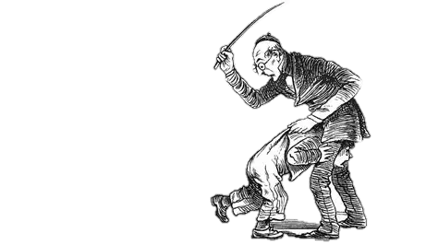
Antiauthoritarian Education in the Bible
1Kings 1:5 Then Adonijah the son of Haggith exalted himself, saying, I will be king; and he prepared for himself chariots and horsemen, and fifty men to run before him.
6 (Now his father had
not hurt him at any time
by saying, Why have you done so?
He was also very good in appearance.
And his mother had borne him after Absalom.)

Slide 35
Good Antiauthoritarian Education
However, some aspects of antiauthoritarian education, like encouraging critical thinking, fostering creativity, and respecting individuality, may align with Christian principles of nurturing each person's unique God-given gifts and purpose.
A balance might be seen as ideal
—
valuing authority while also empowering individuals to grow in wisdom and faith.
Notes:
David Absalom

Slide 36
The fight insight
17 For the flesh lusts against the Spirit, and the Spirit against the flesh: and these are contrary the one to the other:
so that you cannot do the things that you would.

Slide 37
The fight insight
Body
Soul
Spirit
Holy Spirit
Notes:
Don’t loose it

Slide 38
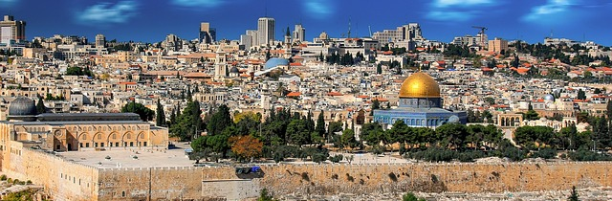

KING David
Lies
Wife's
Bloodshed
Renew spirit
Joy of salvation
Depression when I kept silent
Notes:
Although a lot of flaws but David was a healthy and cheerful man
Observing
Forgiving
John 3:20
²⁰ For everyone that does evil hates the light, neither comes to the light, lest his deeds should be reproved. John 3:20
A PSALM OF DAVID, MASCHIL.
​¹ Blessed is he whose transgression is forgiven, whose sin is covered. Psalms 32:1

Slide 39
TRANSGRESSION IS FORGIVEN
Psalms 32:1 Blessed is the man whose transgression is forgiven, whose sin is covered. 2 Blessed is the man to whom JHWH does not impute iniquity, and in whose spirit there is no guile. 3 When I kept silent, my bones wore out through my roaring all day long. 4 For by day and night Your hand was heavy upon me; my sap was turned into the drought of summer. Selah. 5 I declared my sin to You, and my iniquity I have not hidden. I said, I will confess my transgression to JHWH, and You forgave the iniquity of my sin. Selah. 6 For this let everyone who is godly pray unto You, in a time when You may be found; surely in the floods of great waters they shall not come near him. 7 You are my hiding place; You shall preserve me from distress; You shall enclose me with shouts of deliverance. Selah. 8 I will instruct you and teach you in the way which you should go; I will counsel you with My eye. 9 Do not be like the horse, or like the mule, which have no understanding, whose mouth must be held in with bit and bridle, so that they do not come near you. 10 The wicked has many sorrows, but mercy envelops him who trusts in JHWH. 11 Be glad in JHWH and rejoice, you are righteous; and shout for joy, all you upright in heart.

Slide 40


Slide 41
Behavior in Proverbs
Foolishness
Laziness
Shamefulness
anxiety because being effeminate
  In the world ye shall have tribulation: but be of good cheer; I have overcome the world. (John 16:33)
Loosing the kingdom of GOD because of ignorance
Loosing the kingdom of GOD if you do not fight for it
1 Corinthians 5:9-11
1 Corinthians 6:9-10
Notes:
Μαλακος = malleable, soft, mild, smooth, squashy, mellow
1 Corinthians 6:9-10
Know ye not that the unrighteous shall not inherit the kingdom of God? Be not deceived: neither fornicators, nor idolaters, nor adulterers, nor effeminate, nor abusers of themselves with mankind, ¹⁰ Nor thieves, nor covetous, nor drunkards, nor revilers, nor extortioners, shall inherit the kingdom of God.
1 Corinthians 5:9-11
⁹ I wrote unto you in an epistle not to company with fornicators: ¹⁰ Yet not altogether with the fornicators of this world, or with the covetous, or extortioners, or with idolaters; for then must ye needs go out of the world. ¹¹ But now I have written unto you not to keep company, if any man that is called a brother be a fornicator, or covetous, or an idolater, or a railer, or a drunkard, or an extortioner; with such an one no not to eat.

Slide 42
not worthy of me:
Mt 10:37 He that loveth father or mother more than me is not worthy of me:
Do you love me more Yeshua asked
Jn 21:15 So, when they had dined, Jesus saith to Simon Peter, Simon, son of Jonas, do you love me more than these? He saith unto him, Yea, Lord; you know that I love you. He saith unto him, Feed my lambs.
Notes:
If you do not love Jesus more than others you can’t be a follower of Yeshua you still follow others

Slide 43
Somato-Psychic illnesses
how do physical conditions influence mental states. Chronic pain, for instance, can lead to depression, and hormonal imbalances might cause mood disorders.
---It's fascinating how interconnected the mind and body are. Can you give me a specific example ???
Chronic pain or conditions like hyperthyroidism can lead to irritability and anger.
---It’s a feedback loop—physical discomfort adds stress,
and that stress can worsen the physical symptoms.
---A Frustrating devil's cycle, right?
Notes:
hyperthyroidism = overactivity of the thyroid gland, resulting in a rapid heartbeat and an increased rate of metabolism.
irritability --- the quality or state of being irritable. Symptoms include insomnia and irritability

Slide 44
Psycho - Somatic illnesses
Tension Headaches: These are headaches caused by stress or anxiety, leading to muscle tension in the head and neck.
Irritable Bowel Syndrome (IBS): A gastrointestinal disorder influenced by stress and anxiety, causing symptoms like abdominal pain, bloating, and changes in bowel habits.
Chronic Fatigue Syndrome: A condition characterized by extreme fatigue that is not improved by rest and may be exacerbated by mental stress.
Hypertension: High blood pressure that can be influenced by stress and anxiety, potentially leading to serious health issues.
Notes:
Psycho-somatic illnesses Somatic illnesses are real physical symptoms that are caused or exacerbated by mental factors like stress or anxiety. Some exa..."

Slide 45

Add bloodpresure

Slide 46


Slide 47
Lust
Galatians 5:19 Now the works of the flesh are evident, which are: adultery, sexual perversion, uncleanness, licentiousness, 20 idolatry, sorcery, hatred, contentions, jealousies, outbursts of wrath, selfish ambitions, dissensions, heresies, 21 envy, murders, drunkenness, revelries, and the like; of which I tell you beforehand, just as I also told you in time past, that those who practice such things will not inherit the kingdom of God.
Galatians 5:24 And those who are Christ's have crucified the flesh with its passions and lusts.
[VW] Titus 3:3 For we ourselves were also once foolish, disobedient, led astray, enslaved to various lusts and pleasures, living in malice and envy, hateful and hating one another.

Slide 48
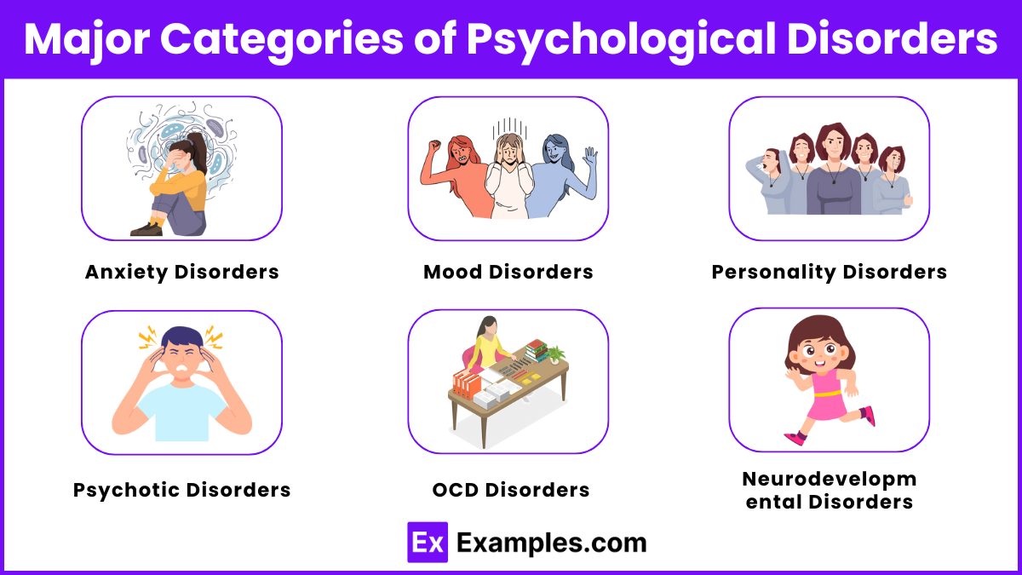
Major Categories of Psychological Disorders

Slide 49
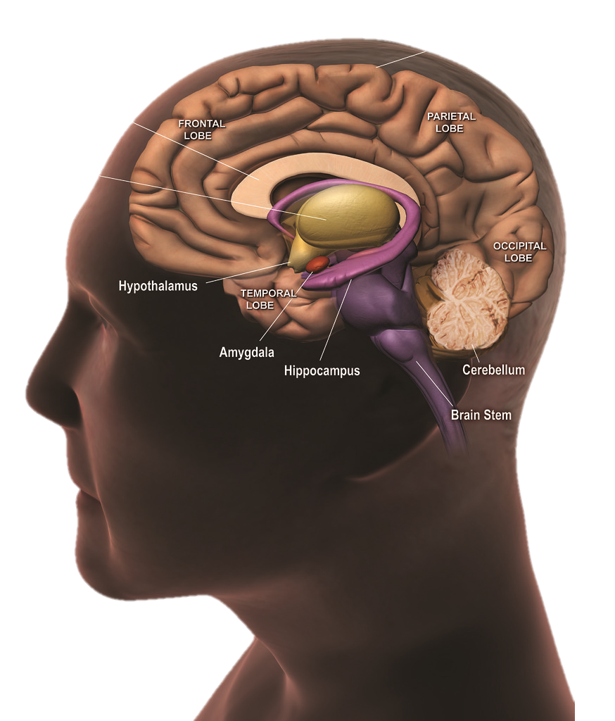
Borderline
Personality
Disorder
Anxiety Disorder
06
01
Neuro-
developmental
Disorder
Mood Disorder
07
02
Psychotic
Disorder
Obsessive
Compulsive
Disorder
08
03
Eating
Disorder
Post Traumatic
Stress
Disorder
09
04
Impulse-Control
Addictive
Disorder
Somatic
Symptom
Disorder
10
05

Slide 50
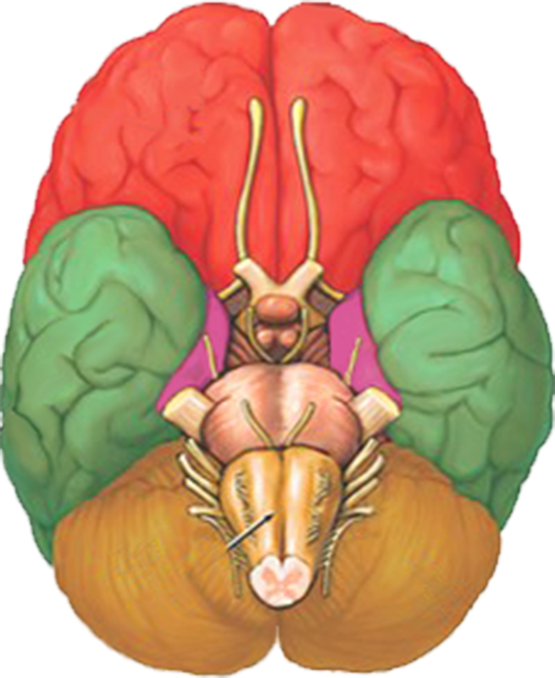
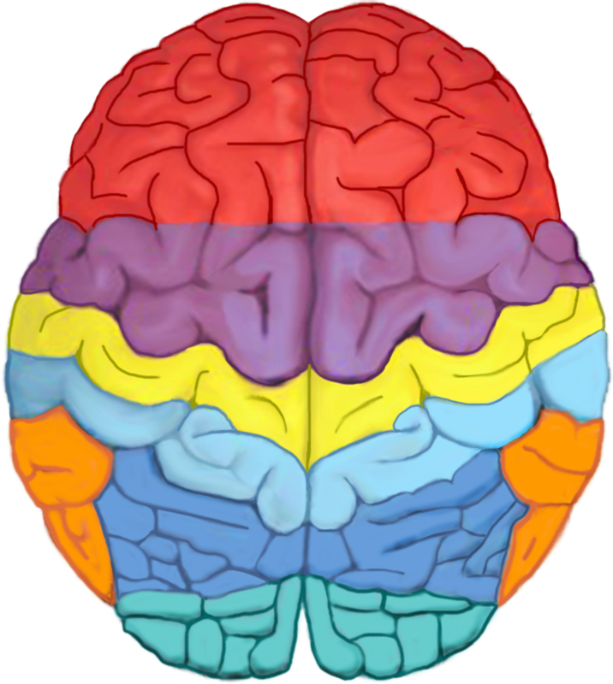
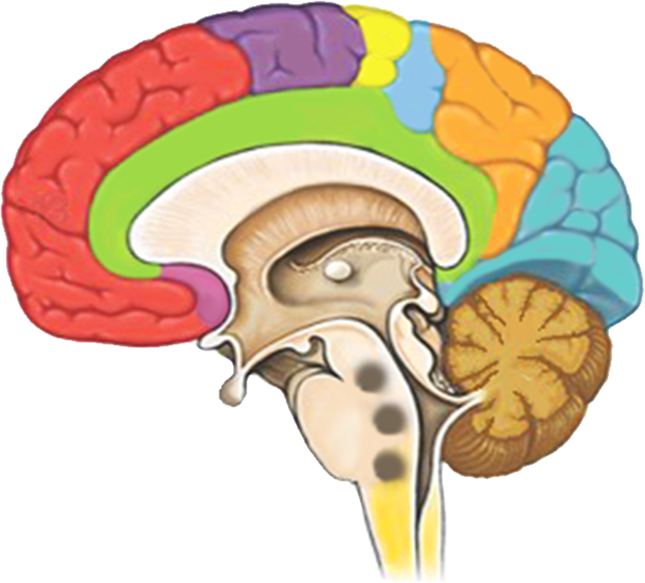
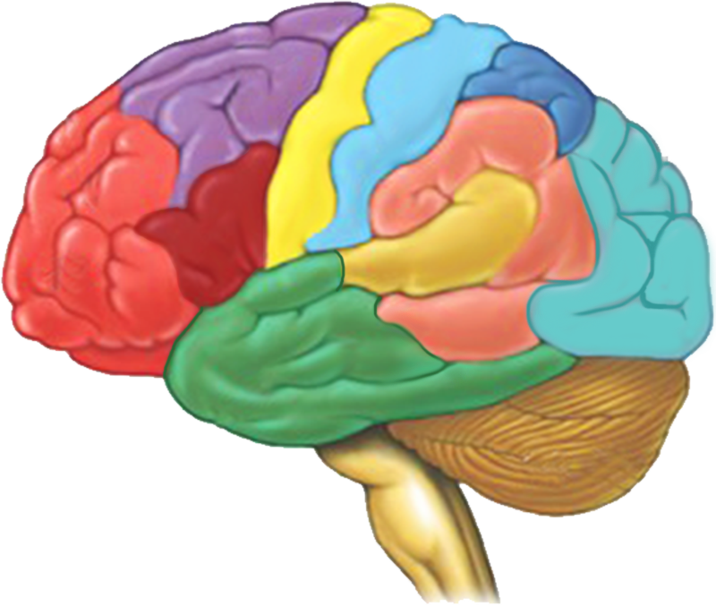
1
Higher Mental Functions:
Concentration
Planning
Judgement
Emotional Expressions
Creativity
Inhibition
10
Visual Area:
Sight
Image recognition
Image perception
11
Motor Functions:
Coordination of Movement
Balance and equilibrium
Posture
2
Broca Area:
Muscles of speech
7
Wernicke’s Area:
Written and spoken
language comprehension
3
12
14
Sensory Association Area:
Motor Function Area:
Eye movement
and orientation
Olfactory Area:
Smelling
8
Association Area:
Short term memory
Equilibrium
Emotion
4
Motor Function Area:
Initiation of voluntary muscles
13
Emotional Area:
Pain
Hunger
“Fight or Flight” response
5
Sensory Area:
Sensation from
muscles and skin
9
Auditory Area:
Hearing
6
Somatosensory Association Area:
Evaluation of weight, texture,
temperature, etc.
for object recognition

Slide 51

Our Goal is Fruit
Cut off all rotten branches
Cut off too many leaves
Water it
Fertilize it
Dig around it

Slide 52
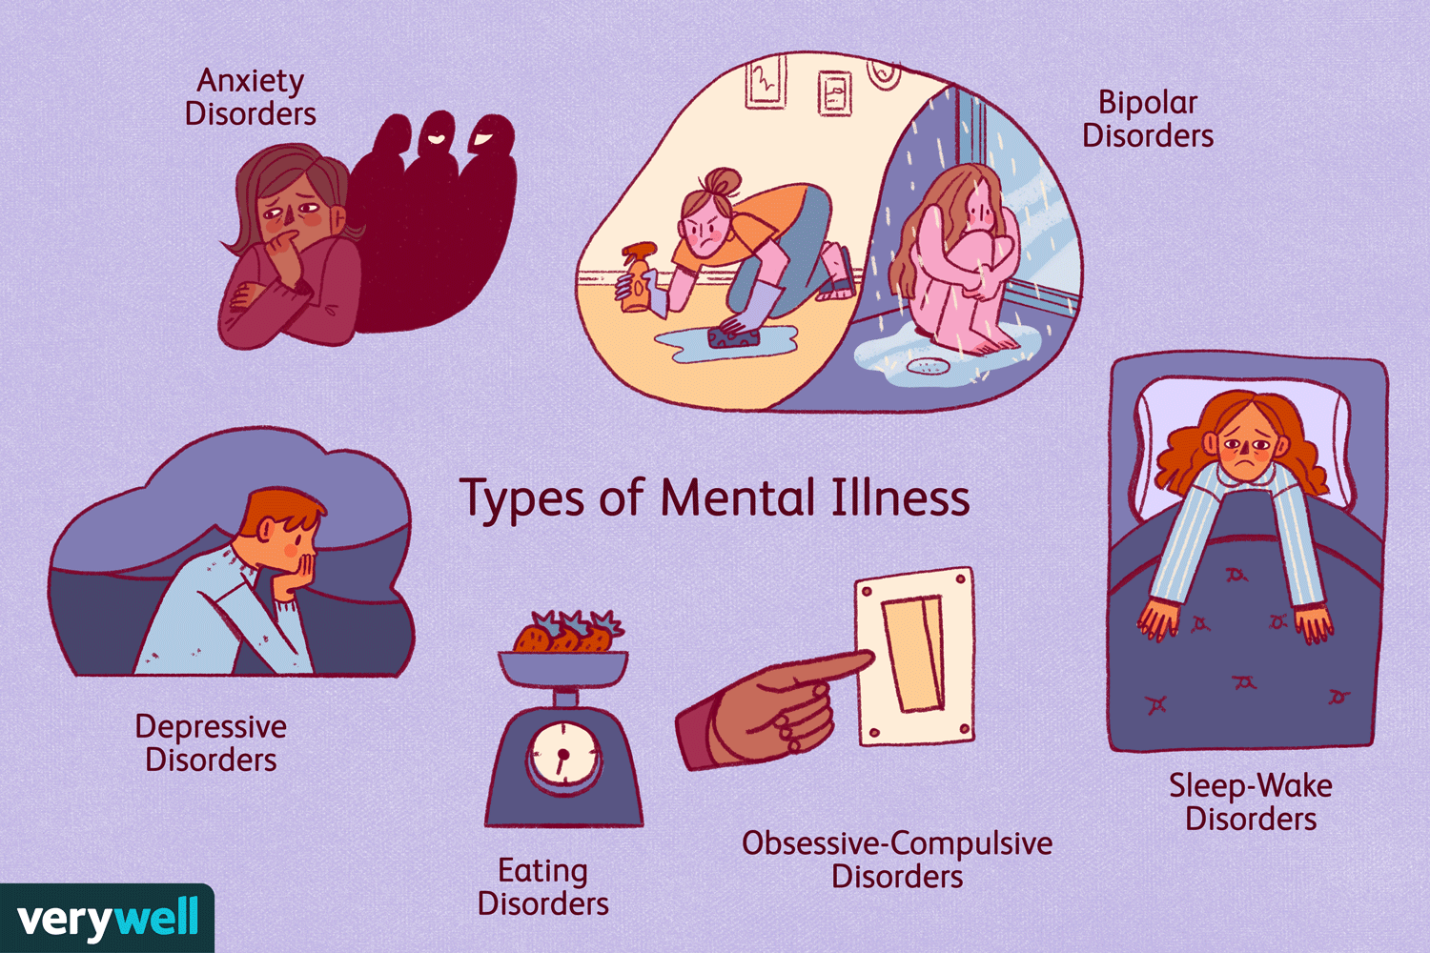
1. Anxiety Disorders
Anxiety
01
13
Emotional Area:
Pain
Hunger
“Fight or Flight” response
  Generalized Anxiety Disorder (GAD)
  Social Anxiety Disorder
Panic Disorder
Phobia
13
Corpus Callosum
Notes:
A panic disorder and a phobia are both types of anxiety disorders, but they have distinct characteristics and triggers.
A panic disorder is characterized by recurrent and unexpected panic attacks. These are sudden periods of intense fear or discomfort that peak within minutes and can include symptoms like heart palpitations, sweating, trembling, shortness of breath, and a feeling of impending doom. People with panic disorder often worry about when the next attack will occur and may avoid places or situations where previous attacks have happened 1.
On the other hand, a phobia is an intense, irrational fear of a specific object, situation, or activity that is generally not harmful. Common phobias include fear of heights (acrophobia), fear of flying (aviophobia), and fear of certain animals (like spiders or snakes). The fear experienced in phobias is usually out of proportion to the actual danger posed by the feared object or situation, and individuals with phobias often go to great lengths to avoid their triggers 1.

Slide 53
Anxiety
Anxiety Disorder
A normal reaction to
stress or difficult times
Comes without cause
Triggered by a
specific stressor
Intense or improper response
Can last weeks and beyond
With start and ending point
Anxiety
01
Can be helpful and
motivational
Disturbs daily life
Physical symptoms
sweating, trembling,
lightheadedness, racing heart
Disappears after situation
Relaxing makes you feel better
It’s a response to a bad situation
Feels like impossible to control

Slide 54
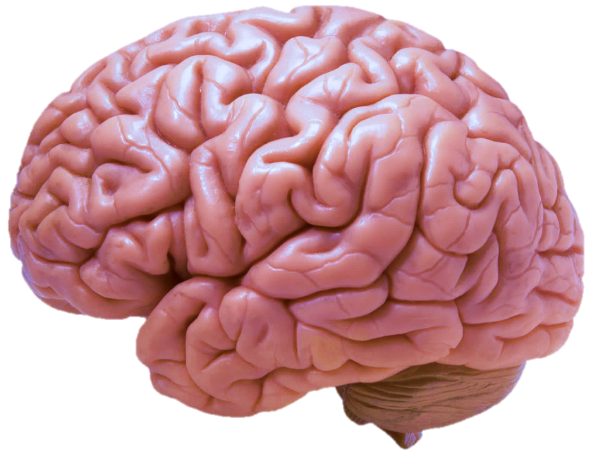
Cerebral Cortex

Slide 55
2. Mood Disorders
Mood Disorder
02
Corpus Callosum
- Major Depressive Disorder
- Bipolar Disorder
13
Emotional Area:
Pain
Hunger
“Fight or Flight” response

Slide 56
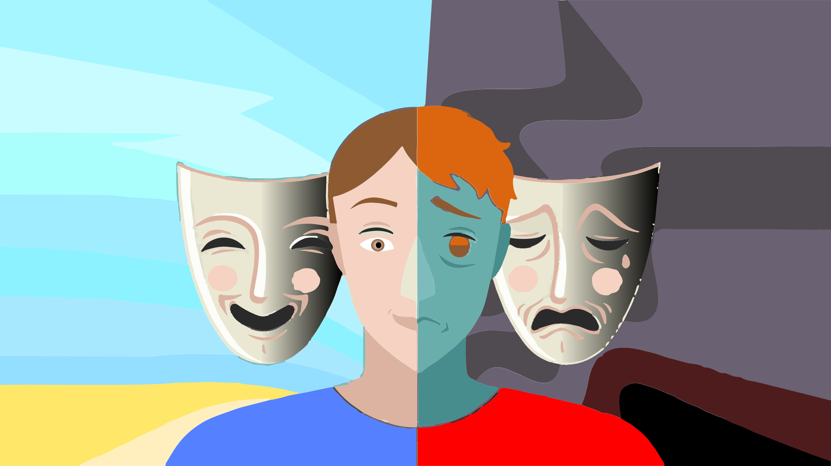
Mood Disorder
Bipolar
02
Notes:
Bipolar disorder is a mood disorder characterized by extreme mood swings that include emotional highs (mania or hypomania) and lows (depression). These mood swings can affect sleep, energy, activity, judgment, behavior, and the ability to think clearly.
During manic episodes, individuals may feel euphoric, full of energy, or unusually irritable. They might engage in risky behaviors, have racing thoughts, and experience a decreased need for sleep. Hypomania is a milder form of mania that doesn't cause as severe disruptions in daily life.
During depressive episodes, individuals may feel sad, hopeless, or lose interest in most activities. They might experience fatigue, changes in sleep patterns, and difficulty concentrating.
Bipolar disorder is typically managed with a combination of medication and psychotherapy to help stabilize mood swings and improve overall functioning 1.

Slide 57
3. Obsessive-Compulsive and Related Disorders
Obsessive
Compulsive
Disorder
03
1
Higher Mental Functions:
Concentration
Planning
Judgement
Emotional Expressions
Creativity
Inhibition
Obsessive-Compulsive Disorder (OCD)
- Body Dysmorphic Disorder
Causes and Risk Factors:
  The exact cause of OCD
  isn't fully understood,
  but it may involve:
  Changes in brain chemistry
  or functioning.
  Genetic predisposition.
  Environmental factors,
  such as infections or stressful life events
Notes:
Obsessions Intrusive thoughts, urges, or images that cause anxiety. Common themes include fear of contamination, doubts, or a need for symmetry
Compulsions Repetitive actions or mental rituals performed to reduce anxiety caused by obsessions. Examples include excessive handwashing, checking locks repeatedly, or arranging items in a specific order
Obsessive-Compulsive Disorder (OCD) is a mental health condition characterized by persistent, unwanted thoughts (obsessions) and repetitive behaviors or mental acts (compulsions) that an individual feels driven to perform. These obsessions and compulsions can significantly interfere with daily life and cause distress.
Obsessions are intrusive and distressing thoughts, images, or urges that repeatedly enter the mind. Common obsessions include fears of contamination, fears of harming oneself or others, and fears of making mistakes.
Compulsions are behaviors or mental acts that an individual performs in response to the obsessions, often to reduce the anxiety or distress caused by them. Common compulsions include excessive cleaning, checking, counting, and repeating actions.
The exact cause of OCD isn't fully understood, but it may involve changes in brain chemistry or functioning, genetic predisposition, and environmental factors such as infections or stressful life events

Slide 58
4. Trauma - and Stressor-Related Disorders
Post Traumatic
Stress
Disorder
04
- Post-Traumatic Stress Disorder (PTSD)
- Acute Stress Disorder
1
Higher Mental Functions:
Concentration
Planning
Judgement
Emotional Expressions
Creativity
Inhibition

Slide 59
5. Somatic Symptom and Related Disorders
Somatic
Symptom
Disorder
05
- Somatic Symptom Disorder SSD
- Illness Anxiety Disorder
6
Somatosensory Association Area:
Evaluation of weight, texture,
temperature, etc. for object recognition
Notes:
Somatic Symptom Disorder (SSD) is a mental health condition where a person experiences intense focus and distress over physical symptoms—
like pain, fatigue, or shortness of breath—even if those symptoms have no clear medical explanation or are relatively mild 2.
What sets SSD apart is not just the presence of physical discomfort, but the excessive thoughts, feelings, and behaviors that come with it.
For example, someone might constantly worry about being seriously ill, frequently visit doctors, or feel that medical care hasn’t been adequate—
even when tests show nothing alarming. Actually, they must admit “no physical diagnosis” still ill They can’t earn money if they ignore this.
It’s important to note that the symptoms are real to the person experiencing them. The distress can significantly interfere with daily life, relationships, and overall well-being 2.
1 https://www.mayoclinic.org/diseases-conditions/somatic-symptom-disorder/symptoms-causes/syc-20377776
2 https://my.clevelandclinic.org/health/diseases/17976-somatic-symptom-disorder-in-adults
3 https://www.psychiatry.org/patients-families/somatic-symptom-disorder/what-is-somatic-symptom-disorder

Slide 60
6. Personality Disorders
Borderline
Personality
Disorder
06
- Borderline Personality Disorder
- Antisocial Personality Disorder
1
Higher Mental Functions:
Concentration
Planning
Judgement
Emotional Expressions
Creativity
Inhibition
13
Emotional Area:
Pain
Hunger
“Fight or Flight” response
8
Association Area:
Short term memory
Equilibrium
Emotion

Slide 61

7. Neurodevelopmental
Disorders
Neuro-
developmental
Disorder
07
Autism Spectrum Disorder (ASD)
Rainman Dustin Hoffman / Tom Cruise
Attention-Deficit Disorder /
Syndrome (ADD or ADS)
Attention-Hyperactivity
Disorder (AHD)
1
Higher Mental Functions:
Concentration
Planning
Judgement
Emotional Expressions
Creativity
Inhibition
Notes:
Honor you father and your mother
Growing up with caring parents is a pleasure for the development of the whole body
When it goes wrong in carelessness many illnesses can follow, we will explore some

Slide 62
Honor you father and your mother
Growing up with caring parents is a pleasure for the development of the whole body
When it goes wrong in carelessness many illnesses can follow, we will explore some

Slide 63




Family Structure
GOD
Giver
Life Guidance Love
Father
Protect Build Lead Provide
Mother
Comfort Teach Nurture
Child
Love learn obey

Slide 64

Emotional and Psychological Health
Neuro-
developmental
Disorder
07
Chronic hunger can lead to mental health issues such as anxiety and depression.
Notes:
Increased Anxiety and Depression:

Slide 65

Physical Growth and Organ Development
Chronic malnutrition can lead to stunted growth, where children are significantly shorter than they could be.
Poor nutrition compromises the immune system, making children more vulnerable to infections and diseases.
Essential organs like the heart, liver, and kidneys can be underdeveloped or function poorly due to lack of nutrients, leading to long-term health issues.
Stunted Growth:
Weakened
Immune System:
Organ Function:
Neuro-
developmental
Disorder
07

Slide 66
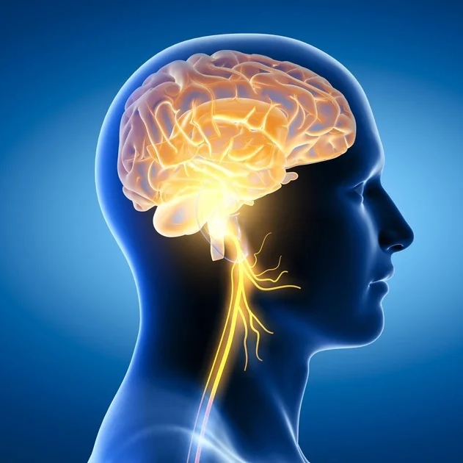
Brain Development
Neuro-
developmental
Disorder
07
Lack of essential nutrients, such as proteins, fats, and vitamins, can delay brain development, affecting learning and perceptive abilities.
Notes:
Delayed Cognitive Development:

Slide 67
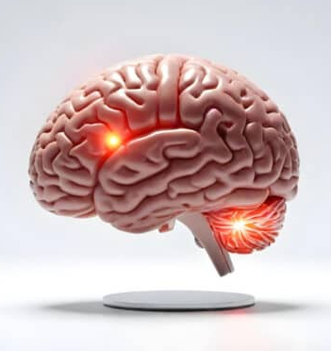
Brain Development
Neuro-
developmental
Disorder
07
Severe malnutrition can result in a smaller brain size, which impacts overall brain function.
Notes:
Reduced Brain Size:

Slide 68
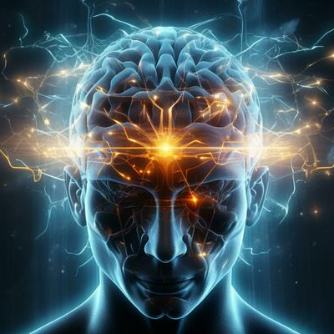
Brain Development
Neuro-
developmental
Disorder
07
Insufficient nutrition can affect the production of neurotransmitters, which are crucial for brain communication and function.
Notes:
Neurotransmitter Production:

Slide 69
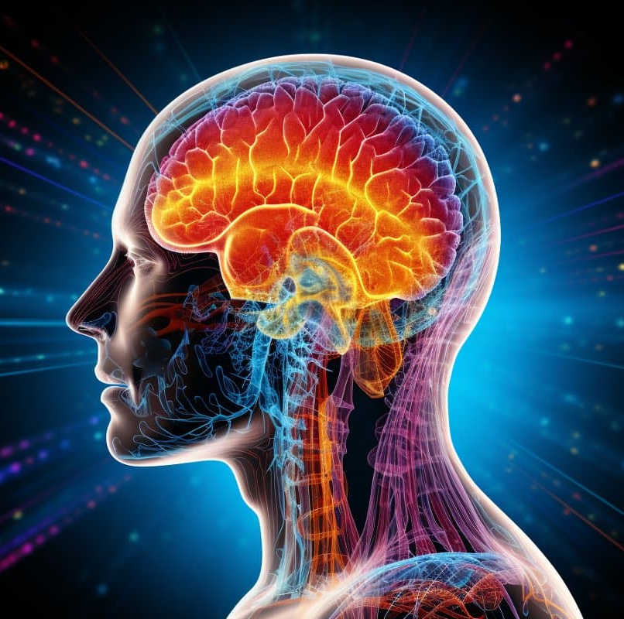
Brain Development
Neuro-
developmental
Disorder
07
Hunger can impair concentration, memory, and problem-solving skills, making it difficult for children to focus and learn effectively.
Notes:
Cognitive Impairments:

Slide 70

Emotional and Psychological Health
Neuro-
developmental
Disorder
07
Hunger can cause behavioral issues, including aggression and hyperactivity.
Notes:
Behavioral Problems:

Slide 71

Emotional and Psychological Health
The stress and stigma associated with hunger can negatively impact a child's self-esteem and social interactions.
Neuro-
developmental
Disorder
07
Notes:
Low Self-Esteem:

Slide 72

Social Maldevelopment
Neuro-
developmental
Disorder
07
Children experiencing hunger may feel isolated and excluded from social activities.
Hunger can lead to delays in reaching developmental milestones, affecting social skills and interactions.

Slide 73
8. Psychotic Disorders
Psychotic
Disorder
08
Schizophrenia - Schizoaffective Disorder
Bipolar Type: This includes episodes of mania or hypomania
2
Broca Area:
Muscles of speech
14
Sensory Association Area:
10
Visual Area:
Sight
Image recognition
Image perception
9
12
Auditory Area:
Hearing
Olfactory Area:
Smelling
Notes:
Schizoaffective Disorder is a complex mental health condition that combines symptoms of schizophrenia and mood disorders. Individuals with this disorder experience psychotic symptoms such as hallucinations and delusions, alongside mood disorder symptoms like depression, mania, or hypomania.
There are two types of Schizoaffective Disorder:
Bipolar Type: This includes episodes of mania or hypomania, and sometimes major depression.
Depressive Type: This includes only major depressive episodes.
Symptoms can vary from person to person and may include:
Delusions: False, fixed beliefs despite evidence to the contrary
Hallucinations: Seeing or hearing things that others do not.
Disorganized Thinking and Speech: Bizarre or unusual behavior.
Mood Symptoms: Periods of manic mood with increased energy and less need for sleep, or depressive symptoms such as feeling empty, sad, or worthless.
Schizoaffective Disorder can significantly impact a person's ability to function in daily life, including work, school, and social settings. Treatment often involves a combination of therapy and medications to manage symptoms and improve quality of life
"Schizoaffective di..."

Slide 74
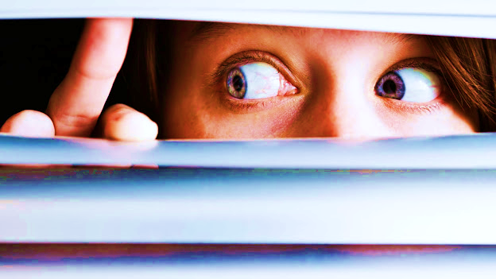
Paranoia
Delusional Disorder
Psychotic
Disorder
08
Notes:
Paranoid Personality Disorder (PPD) and Delusional Disorder.
Paranoia is a mental health condition characterized by intense and irrational long-term mistrust or suspicion of others.
Individuals with paranoia often believe that others are out to harm, deceive, or exploit them,
even when there is no evidence to support these beliefs. This can lead to significant distress and impairment in daily functioning.
Paranoia can manifest in various ways, including:
Delusions of persecution: Believing that others are plotting against them or trying to harm them.
Delusions of reference: Interpreting benign events or comments as having personal significance or being directed at them.
Hypervigilance: Constantly being on guard and scanning the environment for potential threats.
Paranoia can be a symptom of several mental health disorders, including paranoid personality disorder, schizophrenia,
and delusional disorder. Treatment typically involves psychotherapy and, in some cases, medication to help
manage symptoms and , in some cases, medication to help manage symptoms and improve overall functioning

Slide 75



9. Eating Disorders
Eating
Disorder
09
- Anorexia Nervosa
- Bulimia Nervosa
6
Somatosensory Association Area:
Evaluation of weight, texture,
temperature, etc. for object recognition

Slide 76
1
Higher Mental Functions:
Concentration
Planning
Judgement
Emotional Expressions
Creativity
Inhibition
6
Somatosensory Association Area:
Evaluation of weight, texture,
temperature, etc.
for object recognition
11
Motor Functions:
Coordination of Movement
Balance and equilibrium
Posture
7
Wernicke’s Area:
Written and spoken
language comprehension
2
Broca Area:
Muscles of speech
12
8
Association Area:
Short term memory
Equilibrium
Emotion
Olfactory Area:
Smelling
3
Motor Function Area:
Eye movement
and orientation
13
Emotional Area:
Pain
Hunger
“Fight or Flight” response
4
9
Auditory Area:
Hearing
Motor Function Area:
Initiation of voluntary muscles
5
Sensory Area:
Sensation from
muscles and skin
10
Visual Area:
Sight
Image recognition
Image perception
14
Sensory Association Area:

Slide 77
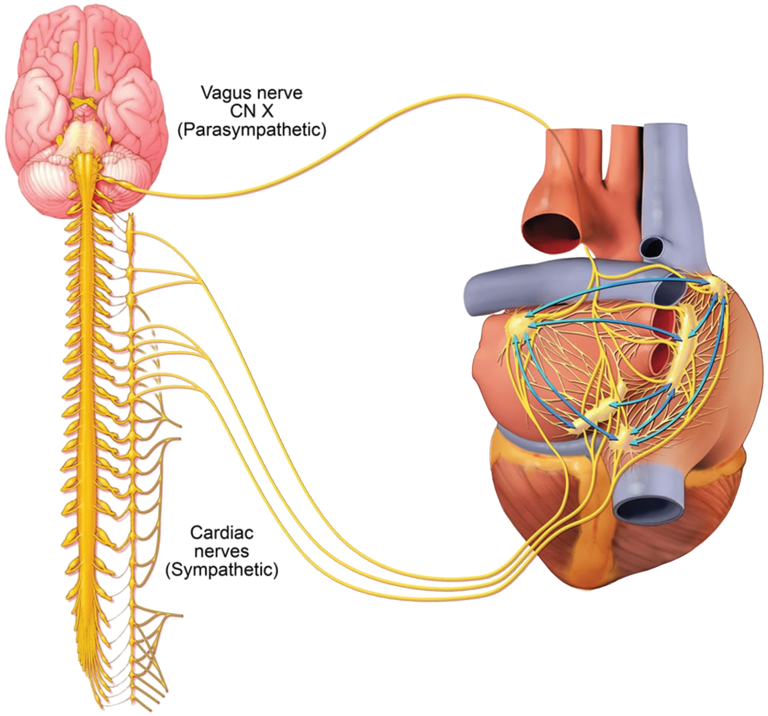
10. Impulse-Control and Addictive Disorders
- Gambling Disorder
- Substance Use Disorder
Impulse-Control
Addictive
Disorder
10
Notes:
Judgement
Proverbs 31:4 not for kings, O Lemuel, not for kings to drink wine; nor for prince's strong drink:
5 Lest they drink, and forget the law, and pervert the judgment of any of the afflicted.
6 Give strong drink unto him that is ready to perish, and wine unto those that be of heavy hearts.
7 Let him drink, and forget his poverty, and remember his misery no more.

Slide 78
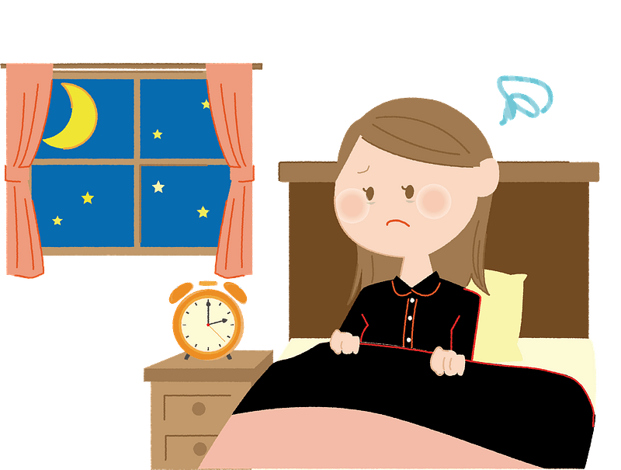

Insomnia
Sleep
Disorder
11
Notes:
Insomnia is a common sleep disorder that makes it difficult for individuals to fall asleep, stay asleep, or both. People with insomnia often experience dissatisfaction with their sleep and may feel tired or have low energy during the day. Insomnia can be acute (short-term) or chronic (long-term), and it can significantly impact daily functioning and overall quality of life.
Insomnia is typically categorized under sleep disorders. It is a condition where individuals have difficulty falling asleep, staying asleep, or getting restful sleep, which can lead to daytime fatigue and other health issues. In your presentation, insomnia is not explicitly mentioned, but it can be associated with various mental health conditions such as anxi.ety disorders, mood disorders, and somatic symptom disorders.
While insomnia is primarily classified as a sleep-wake disorder, it often overlaps with other categories depending on its cause or context:
Psychiatric Disorders: Insomnia frequently coexists with conditions like anxiety, depression, PTSD, and substance use disorders. In these cases, it's considered comorbid insomnia—not just a symptom, but a condition that interacts with the mental health issue.
Neurological or Medical Conditions: Chronic pain, hyperthyroidism, Parkinson’s disease, and even asthma can contribute to insomnia. When linked to these, it’s often categorized under secondary insomnia.
Behavioral and Lifestyle Factors: Stress, irregular sleep schedules, or excessive screen time can lead to what’s sometimes called behavioral insomnia, especially in children.
So while insomnia is rooted in sleep dysfunction, it’s often a multidimensional issue—tied to mental health, physical health, and lifestyle.

Slide 79
Our goal
Body
Soul
Spirit

Slide 80
Fruits of the spirit
Galatians 5:22 But the fruit of the Spirit is love, joy, peace, longsuffering, gentleness, goodness, faith,
23 Meekness, temperance: against such there is no law.
24 And they that are Christ's have crucified the flesh with the affections and lusts.
Notes:
Ephesians 5:9 (For the fruit of the Spirit in all goodness and righteousness and truth;)
10 Proving what is acceptable unto the Lord.
11 And have no fellowship with the unfruitful works of darkness, but rather reprove .

Slide 81

Thank you Jesus
You are our inspiration

Slide 82
1
6
7
Higher Mental Functions:
Concentration
Planning
Judgement
Emotional Expressions
Creativity
Inhibition
Somatosensory Association Area:
Evaluation of weight, texture,
temperature, etc. for object recognition
Wernicke’s Area:
Written and spoken
language comprehension
8
Association Area:
Short term memory
Equilibrium
Emotion
2
Broca Area:
Muscles of speech
9
Auditory Area:
Hearing
3
Motor Function Area:
Eye movement
and orientation
10
Visual Area:
Sight
Image recognition
Image perception
4
Motor Function Area:
Initiation of voluntary muscles
11
Motor Functions:
Coordination of Movement
Balance and equilibrium
Posture
5
Sensory Area:
Sensation from muscles and skin

Slide 83
12
Olfactory Area:
Smelling
13
Emotional Area:
Pain
Hunger
“Fight or Flight” response
Corpus Callosum
Thalamus
Pituitary
Cerebellum
14
Sensory Association Area:

Slide 84
1
Higher Mental Functions:
Concentration
Planning
Judgement
Emotional Expressions
Creativity
Inhibition
3
Motor Function Area:
Eye movement
and orientation
6
9
Somatosensory Association Area:
Evaluation of weight, texture,
temperature, etc.
for object recognition
Auditory Area:
Hearing
4
Motor Function Area:
Initiation of voluntary muscles
10
Visual Area:
Sight
Image recognition
Image perception
5
Sensory Area:
Sensation from muscles and skin

Slide 85
1
Higher Mental Functions:
Concentration
Planning
Judgement
Emotional Expressions
Creativity
Inhibition
12
8
Association Area:
Short term memory
Equilibrium
Emotion
Olfactory Area:
Smelling
11
Motor Functions:
Coordination of Movement
Balance and equilibrium
Posture

Slide 86
